Slide 1
Project Battle of Neighborhoods
Presented by:
Madhavi T

Slide 2
Problem Statement: To create an easy way for relocation specialists to find a location to suit the client’s requirements
For Ex: Find an area in Essex county which fits the criteria mentioned below by using clustering approach which the family thinks adds value to their life style choices and increases their chances of a happy and healthy life
1. Nearby parks/green areas for the kid to play and enjoy
2. Availability of fitness centres to keep the young adults fit
3. Availability of Sport centres for the kid to learn extra curricular activities
4. Easy and nearby entertainment options like theatres etc
5. Restaurant, Bank facilities nearby

Slide 3
Data Requirements
For our analysis we need an overall idea of New Jersey state in general and Essex county in particular.
Use 'https://www.zipcodestogo.com/New%20Jersey/' link to get the postal codes of counties and cities.
Then use "Beautiful soup" to retrieve the postal codes, county and city information from the website.
Geo co-ordinates: The geo location of the city-county should be obtained from Geocoder.
Nearby Venue locations: The venues for each city-county should be obtained from FourSquare.

Slide 4
Methodology
Methodology:
Perform exploratory analysis on data to check if it suits the requirements.
Data with Null values should be removed.
Data should not contain duplicate values.
Data should be formatted correctly and have the correct domain.
Once the data is standardized the qualified data is ready to be processed.
While using Geocoder, it was found that for some of the places the latitudes and longitudes could not be retrieved. The data has been massaged to remove those city-county rows as it doesn’t add value.
While using FourSquare, it was found that for some of the places the nearby venue locations could not be retrieved. The data has been massaged to remove those city-county rows as it doesn’t add value
Then cluster the nearby venues to find out the top ten amenities available for each location and extract those features. Based on the amenities cluster the neighbourhoods which have similar characteristics. These venues can be shown to the clients to choose a location.
Advantage is that given a location, we get an overview of the facilities available and it gives us the knowledge to choose the best options.

Slide 5
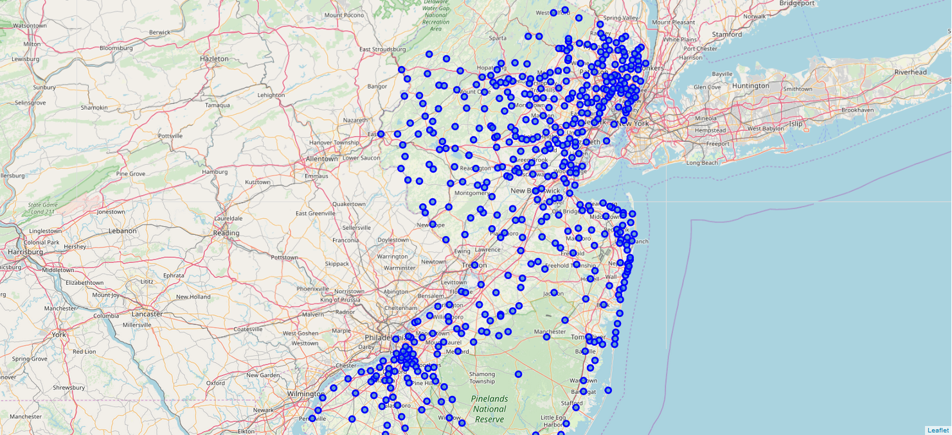
New Jersey Map

Slide 6
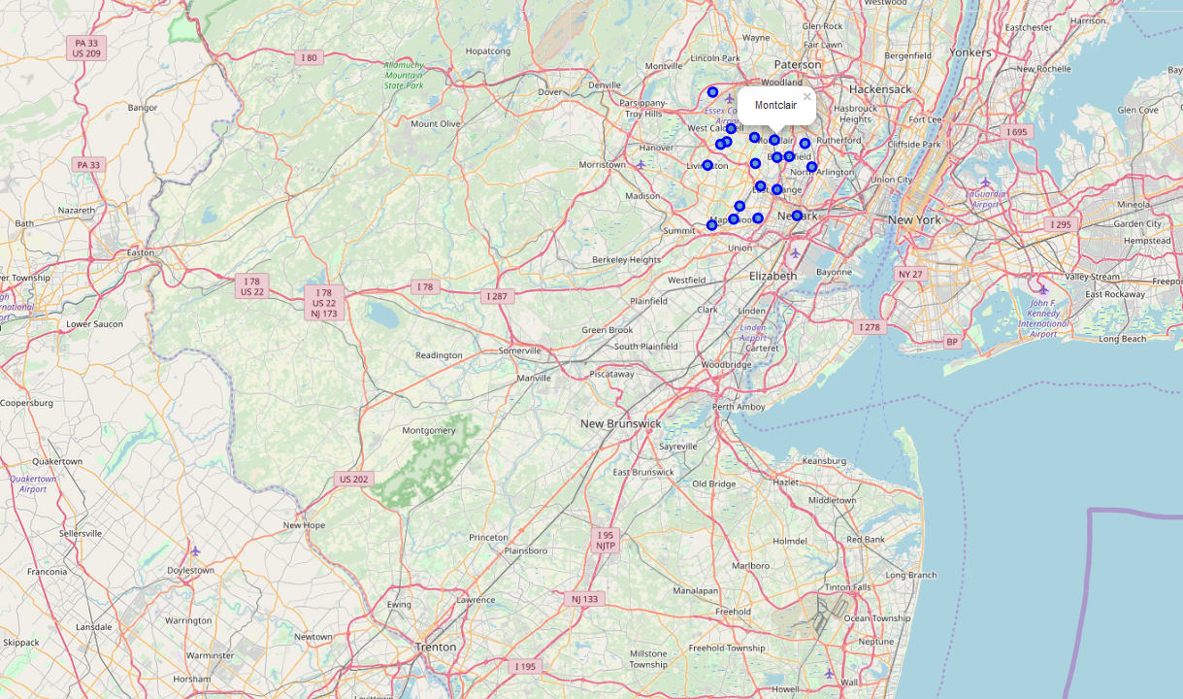
Essex County Map

Slide 7
Results
Based on the amenities available in each area, the city-county combinations are divided into 5 clusters.
Each cluster has a unique amenity.
For example Cluster 1 is the grouping of most happening places consisting of restaurants, malls, banks & entertainment centers
Cluster 2 is the group which contains a natural setting of a lake and some food joints
Cluster 3 & 5 is mostly about food joints and super markets
Cluster 4 is the group which has a historic site, food joints and convenience store

Slide 8
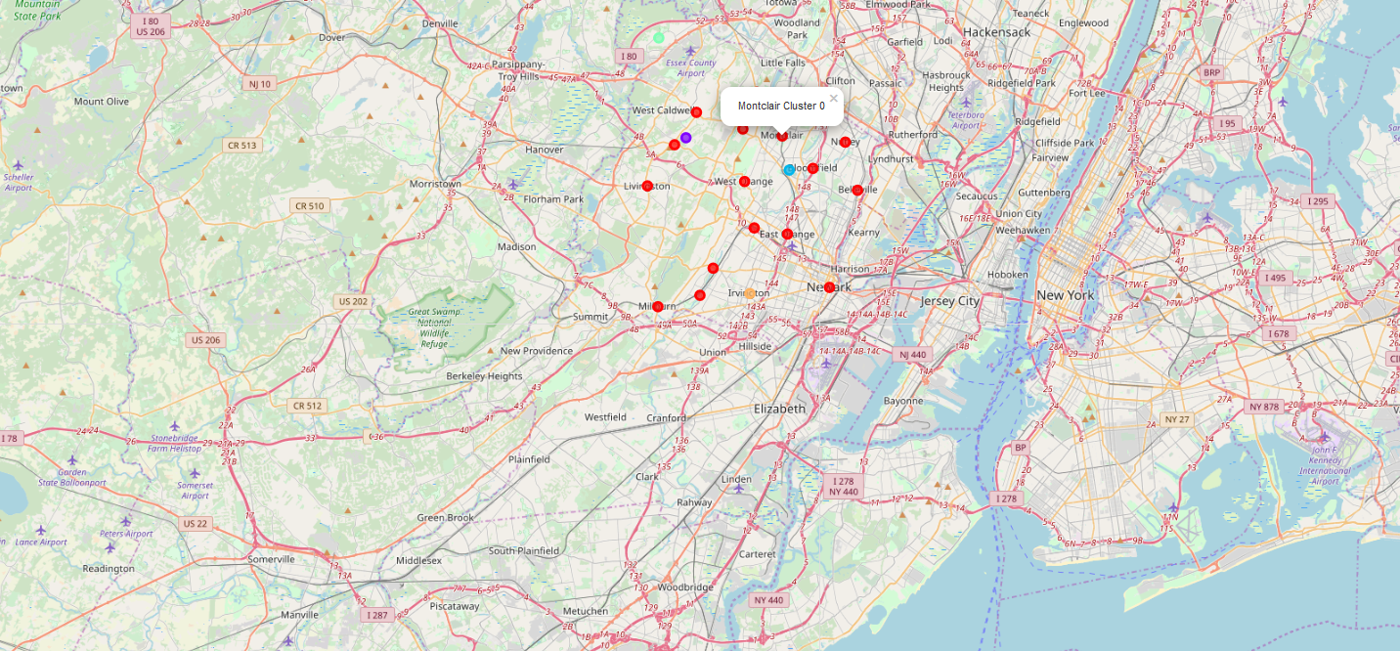
Division of Neighbourhood - 5 Clusters

Slide 9
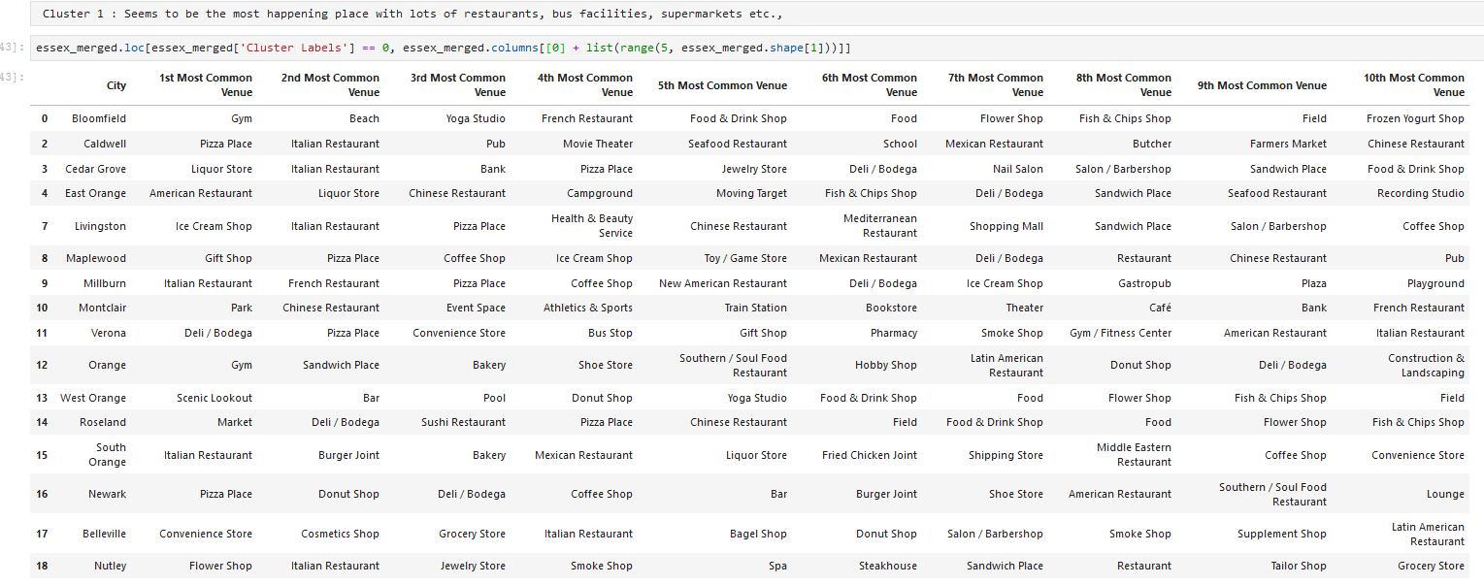
Cluster 1

Slide 10
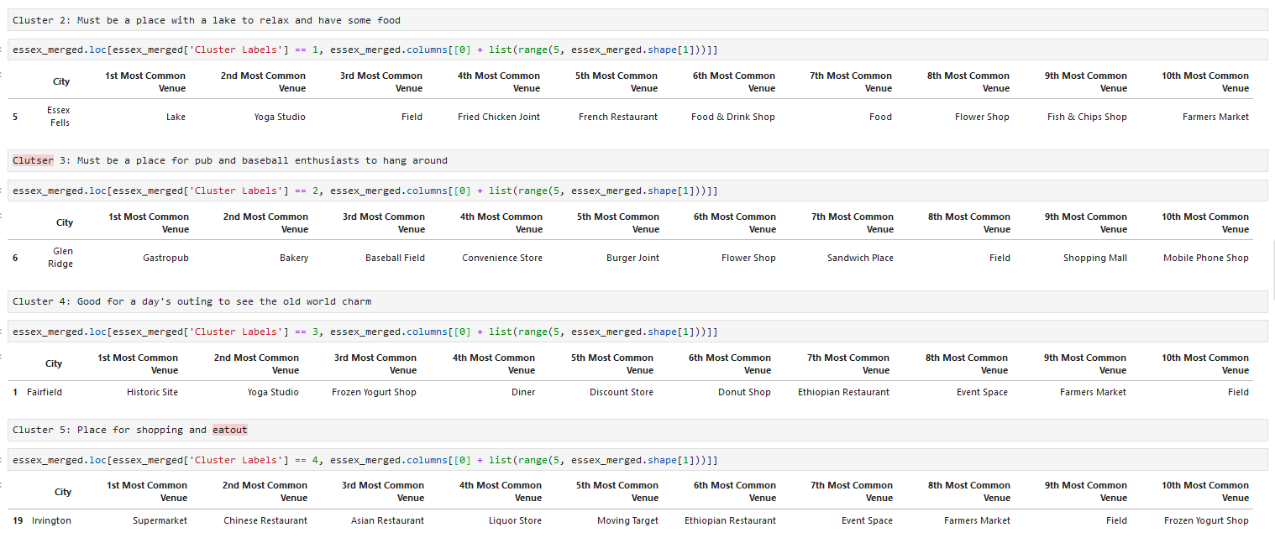
Clusters 2,3,4 & 5

Slide 11
Discussion
Though the data has gone through exploratory analysis, some the issues can be found during actual run of data. For ex: Sussex County has passed through exploratory analysis but could not find a geo location and hence the need to delete the data at a later stage of the process Similar is the case with “Short Hills” area where FourSquare could not find the nearby venues
Hence I see that the Data Science methodology is a highly iterative process which needs going back and forth to tune the data as needed.
We could also find the relevant data which can be shown to the Indian family with a kid as possible accommodation options.

Slide 12
Conclusion
Referring back to the requirement:
Find an area in Essex county which fits the criteria mentioned below by using clustering approach which the family thinks adds value to their life style choices and increases their chances of a happy and healthy life
1. Nearby parks/green areas for the kid to play and enjoy
2. Availability of fitness centres to keep the young adults fit
3. Availability of Sport centres for the kid to learn extra curricular activities
4. Easy and nearby entertainment options like theatres etc
5. Restaurant, Bank facilities nearby
From the data, we find that Montclair in Essex county is the most suitable option for the family given the below facilities
City | 1st Most Common Venue | 2nd Most Common Venue | 3rd Most Common Venue | 4th Most Common Venue | 5th Most Common Venue | 6th Most Common Venue | 7th Most Common Venue | 8th Most Common Venue | 9th Most Common Venue | 10th Most Common Venue
Montclair | Park | Event Space | Cosmetics Shop | Café | Chinese Restaurant | Bookstore | Bank | Theater | Train Station | Flower Shop

